Slide 1
HYDROGEN PRODUCTION METHODS

Slide 2
HYDROGEN PRODUCTION
Natural Gas
(Steam methane reforming
Current process today)
Fuel cells
Engines / Turbines
Renewable
Sources
(Wind,Solar,biomass,
Hydro,geothermal)
Fuel
Petroleum
Recovery &Refining
Hydrogen
Clean energy
carrier
Petroleum
Recovery &Refining
Nuclear
Chemical
Methanal Production
Coal
(with Carbon
Sequestration)
Electronics
Ammonia production
Methanal Production & Fabrication
Food processing
cosmetics

Slide 3
HYDROGEN PRODUCTION METHODS
Hydrogen Production Methods
Fossil Fuel
Renewable Sources
Hydrocarbon Reforming
Hydrocarbon Pyrolysis
Biomass Process
Water Splitting
Steam Reforming
Partial Oxidation
Autothermal Reforming
Thermolysis
Photolysis
Electrolysis
Alkaline
Solid Oxide
PEM
Biological
Thermochemical
Bio-photolysis
Dark Fermentation
Photo Fermentation
Gasification
Pyrolysis
Combustion
Liquefaction

Slide 4
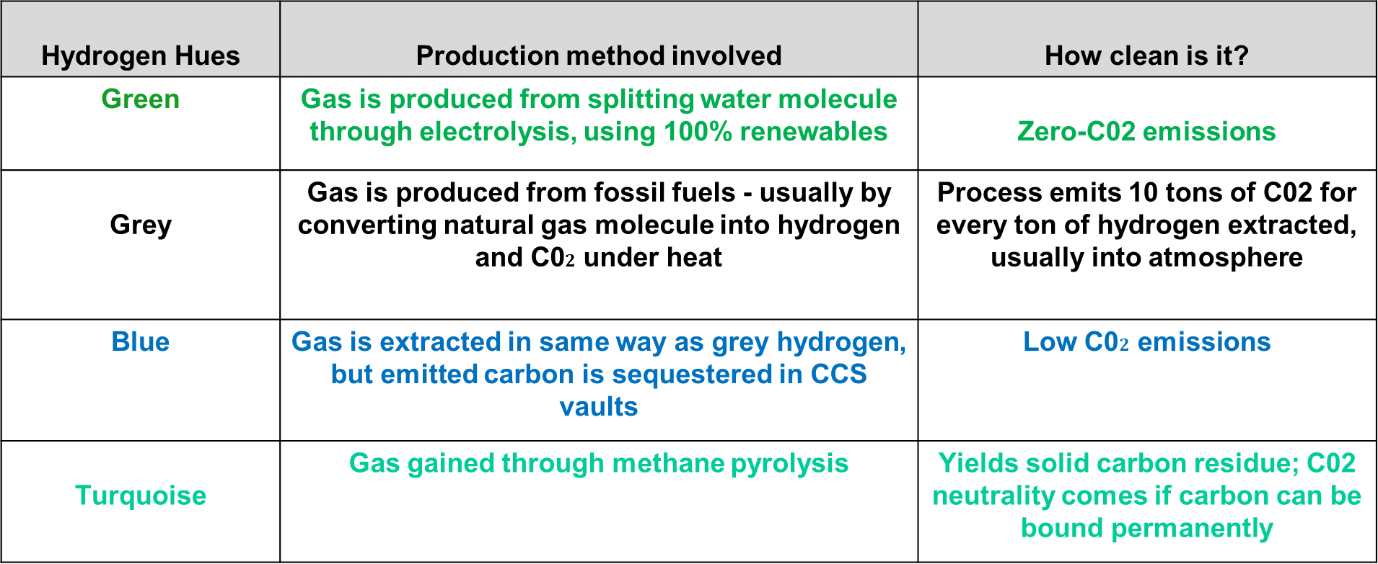
COLOURS OF HYDROGEN
Hydrogen Hues | Production method involved | How clean is it?
Green | Gas is produced from splitting water molecule through electrolysis, using 100% renewables | Zero-C02 emissions
Grey | Gas is produced from fossil fuels - usually by converting natural gas molecule into hydrogen and C0$2$ under heat | Process emits 10 tons of C02 for every ton of hydrogen extracted, usually into atmosphere
Blue | Gas is extracted in same way as grey hydrogen, but emitted carbon is sequestered in CCS vaults | Low C0$2$ emissions
Turquoise | Gas gained through methane pyrolysis | Yields solid carbon residue; C02 neutrality comes if carbon can be bound permanently

Slide 5
HYDROGEN PRODUCTION FROM FOSSIL FUELS
H2 Source
Process
Gas Cleansing
Coal
Gasification
Hydrocarbon
Liquid HC
Desulphurization
Reforming
Natural Gas
Desulphurization
Water gas Shift

Slide 6
Thank you

